Slide 1

Proposal for Merchandise Management System Project
Created by:Fatema Tuz Zohora
Batch: JEE/CCSL/-M/55/01
Trainee ID:1277609

Slide 2
Course Traineer | Muhammad Emran Hossain Java Trainer | IsDB-BISEW IT Scholarship Programme Khilgaon, Dhaka-1219 +8801619192323 emranhss@gmail.com
Project Consultant | Md. Moshaidul Islam Consultant | Show & Tell Consulting Ltd IsDB-BISEW IT Scholarship Programme 01711071219 moshaidul@gmail.com

Slide 3
Table of contents
01
02
03
Project Overview
System User
Technologies used

Slide 4
01
Project Overview

Slide 5

Project Overview
Merchandise management system with Spring Boot, Thyme leaf and MySQL.
Different clothing materials (style codes) and TechPacks are created by the merchandise in accordance with the designer plan.
Customers place orders for specific materials, specifying the size and quantity needed.
The business will then produce a Bill of Material (BOM) that includes the cost of each material by size and labour.

Slide 6
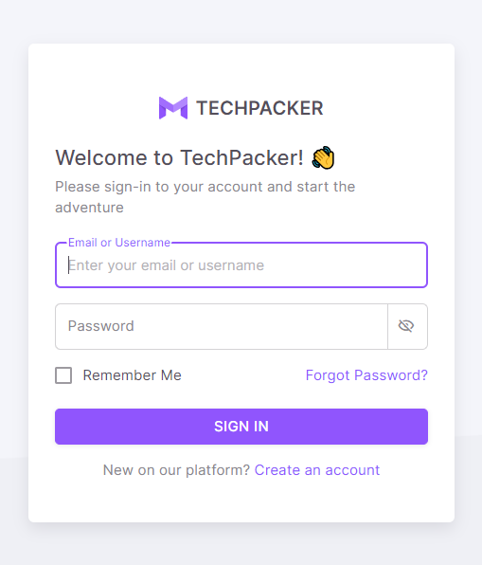
Project Overview
The company also buys raw materials based on how much it requires for production.
For a comprehensive picture of the business process, the order, sales, and revenue are displayed on the dashboard together with the order, buy, and stock tables.

Slide 7
02
System User

Slide 8
The administrator's Role
Task 1
Task 2
Task 3
Create new Style, TechPack, BOM.
View all the Style, TechPack, BOM.
Create new Vendor.
View all the vendors.
Create new Buyers.
View All the Buyers.
Task 4
View All the Orders.

Slide 9
Department Superviser Task
Task 1
Update Tasks’ actual start and end date for Time & Action plan.
Task 2
Update time required to complete a task for individual style.

Slide 10
Buyer Role
Task 1
Task 2
Task 3
Check out Style to give Order.
Place order for different products and communicate with administration side.
Check out order status in buyer’s Dashboard.

Slide 11
03
Technologies used

Slide 12
Technologies used
Front-End Development:
Back-End Development:
Html
Css
JavaScript
Bootstrap
Angular
Spring Boot
JDBC
Servlet
JSP
MySQL

Slide 13
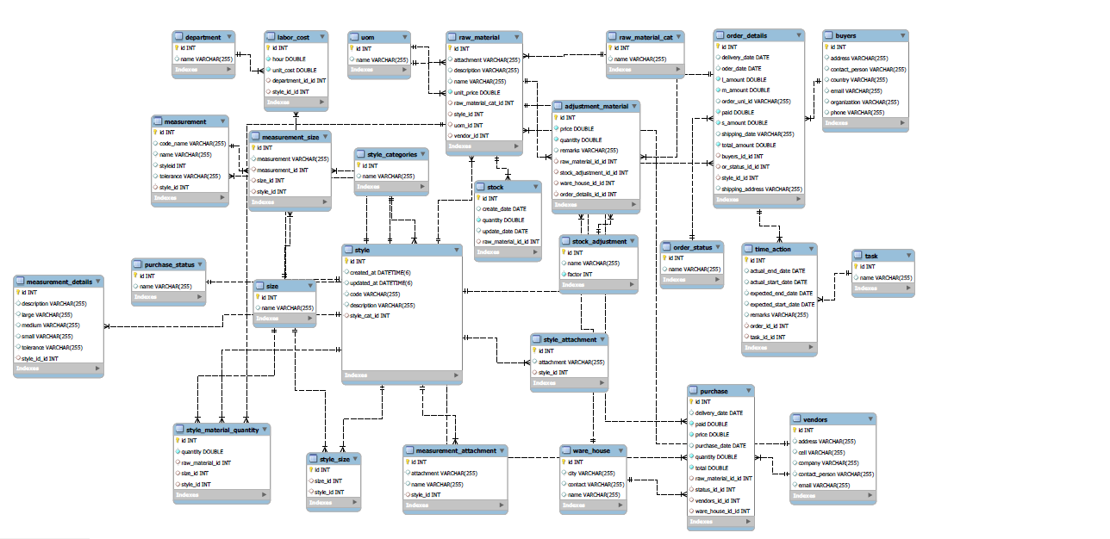
ERD Diagaram

Slide 14
Thanks!
Fatema Tuz Zohora
Enterprise Systems Analysis & Design
JEE Trainee
JEE/CCSL-M/55/01
IsDB-BISEW IT Scholarship Programme,
Dhaka, Bangladesh.
GitHub: fatemazohor
Email: fatematuzzohora289@gmail.com
Please keep this slide for attribution

Slide 15
ERD diagram link

